Slide 1
Miscellaneous items
Everyone completed lab2 with 3 points
files submitted to My courses must
Use naming convention given: assignment_lastname_firstname_tar.gz
Contain no .o or executable files
Can tar and zip with one command
Tar –cvzf assignment_lastname_firstname_tar.gz dir_Name
To change your CS Lab password go to
Sysadmin.cs.Binghamton.edu
to compile using c++11
Zybooks environment uses C++ by default
Cs lab environment does not
Use: g++ -std=c++11 -----.cpp

Slide 2
Questions about lab or assignment ???

Slide 3
Before Thursday’s class do zybook exercises chapter 10 (.8 through .15) Chapter 11

Slide 4
What are the 3 cornerstones of OOP?

Slide 5
Cornerstones of oop
Inheritance
Polymorphism
Encapsulation - main focus in CS240

Slide 6
encapsulation
A stringstream object encapsulates a string
A vector<t> object encapsulates an array
A function encapsulates ?????
abc

Slide 7
A function encapsulates an algorithm
algorithm

Slide 8
A class encapsulates data that can be accessed only through operations (methods)
operations
operations
data
data

Slide 9
Cs240 focuses on containers of like items
will use classes for
The type of items to be stored in a container
The container
List
Map
Graph

Slide 10
Some differences between java classes and c++ classes
A java class is defined and implemented in a single file
A c++ class is defined in one file and implemented in another file
Java objects are references
C++ objects are values
A c++ class can have methods that are overloaded operators
Ex: MyObject == yourobject
Ex: cout << myobject << endl;

Slide 11
The box class
An object of the box class holds a single type of item
A jewelry box
A book box
A bait box
A junk box
What can be done to/with a box?
Create a box
Find out the type of item stored in a box
Set the type of item stored in a box
Add an item to the box
Remove an item from the box
How many items in the box?

Slide 12
public class Box {
private String itemType;
private int numItems;
public Box( ) {
itemType = “unknown”;
numItems = 0;
}
public Box (String theType) {
itemType = theType;
numItems = 0;
}
public setItemType (String theType) {
itemType = the Type;
}
public String getItemType ( ) {
return itemType;
}
public void addItem (){
numItems = numItems + 1;
}
public void removeItem (){
numItems = numItems - 1;
}
public int howManyItems(){
return numItems;
}
}
The Java Box class

Slide 13
Syntax of C++ class statement
class MyClass
{
public:
//protypes for constructors //prototypes for operations (methods) accessible to user private: //data members needed to store value of an instance
//prototypes for operations not accessible to user
};
C++ class definition goes in a .h file
C++ class implementation goes in a .cpp file

Slide 14
// box.h
#include <string>;
class Box {
public:
Box ();
// default constructor
Box (std::string theType);
// constructor
void setItemType (std::string theType);
// set type of item to theType
std:string getItemType ( ) const;
// return type of item
void addItem();
// add an item to the box
void removeItem();
// remove an item from the box
int howManyItems() const;
// return number of items in the box
private:
std::string itemType;
int numItems;
};
C++ definition of
the Box class

Slide 15
// file box.cpp
#include “box.h”
Box::Box() {
itemType = “unknown”;
numItems = 0;
}
Box::Box(std::string theType) {
itemType = theType;
numItems = 0;
}
void Box::setItemType (std::string theType) {
itemType = theType;
}
std::string Box::getItemType ( ) const {
return itemType;
}
void addItem() {
numItems ++;
}
void removeItem() {
numItems --;
}
int howManyItems() const {
return numItems;
}
C++ implementation
of the Box class

Slide 16
Declaring class instances (objects)
Java - objects are references
Box myBox = new Box();
Box myBox = new Box(“books”);
C++ - objects are values
Box mybox ();
Box mybox (“books”);
Box* myboxptr = new box(“books”); (coming later)

Slide 17
Using the box class
First write a program whose purpose is test the box class to be sure that its methods provide the expected behavior
Test program needs to
#include “box.h”
Declare instances of type box
Invoke all methods of the box class

Slide 18
Code is now spread over 3 files
box.h - defines the class interface
box.cpp - implements the class
boxtester.cpp - program to test the behavior of the box class
Both box.cpp and boxtester.cpp #include box.h
Attempt to define a class twice results in a compiler error

Slide 19
preventing redefinition
// box.h
#ifndef _BOX_
#define _BOX_
#include <string>;
class Box
{
…………
};
#endif

Slide 20
HOW DO WE CREATE AN EXECUTABLE FILE?
box.cpp
boxtester.cpp
#include “box.h”
#include “box.h”
compile
link
box.o
boxtester.o
executable file

Slide 21
The UNIX make program
use to manage multifile projects
Keeps track of changes made in source files
Make looks for its instructions in a file named makefile (all lower case)
A Makefile contains
Comment lines – start with #
Dependency lines followed by action lines
An example:
box.o: box.cpp box.h <- a dependency line g++ -c std=c++11 box.cpp <- an action line
Action line must start with a tab!

Slide 22
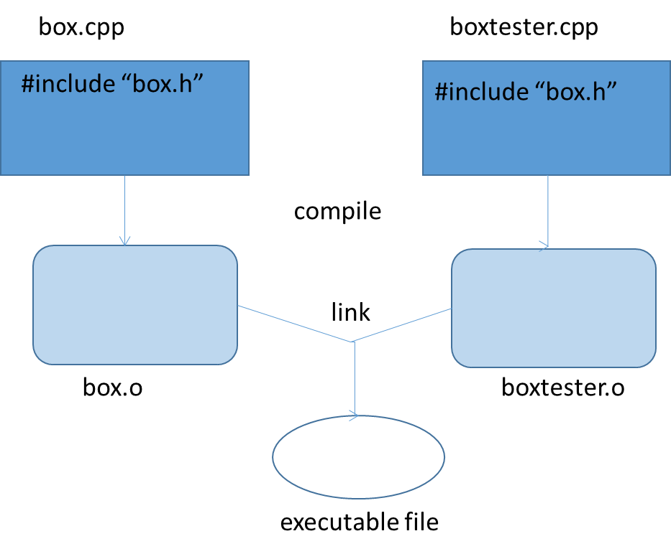
A makefile
boxProgram.exe: box.o boxtester.o
g++ box.o boxtester.o -o boxProgram.exe
box.o: box.cpp box.h
g++ -c -std=c++11 box.cpp
boxtester.o: boxtester.cpp box.h
g++ -c -cstd=c++11 boxtester.cpp

Slide 23
Benefits of make
Don’t have to type individual commands
Will only recompile the files that have been changed since the last time make was executed
Done by checking time stamps
Has many other uses

Slide 24
A useful addition
boxProgram.exe: box.o boxtester.o
g++ box.o boxtester.o -o boxProgram.exe
box.o: box.cpp box.h
g++ -c -std=c++11 box.cpp
boxtester.o: boxtester.cpp box.h
g++ -c -cstd=c++11 boxtester.cpp
clean:
rm *.o *.exe

Slide 25
Future submissions to mycourses must include
All .h and .cpp files needed to build the executable program
A makefile with commands needed to build the executable program
Any input files needed to run the program
Nothing else
No .o files
No executable files

Slide 26
Another example
Abstract view of a fraction object
What operations are needed?
What data members are needed?
2 / 5

Slide 27
A partial header file
#ifndef _FRACTION_
#define _FRACTION_
class Fraction{
public:
Fraction():
// creates a Fraction with the value 1/1
Fraction(int initNumerator, int initDenominator)
// creates a Fraction with the value initNumerator / initDenominator
// precondition: initDenominator != 0
int getDenominator()const;
// returns the denominator
int getNumerator()const;
// returns the numerator
double getFloatValue()const;
// returns fraction’s float value
private:
int num;
int denom;
};
#endif

Slide 28
Some additions to fraction class
Doing arithmetic with fractions
F3 = f1 + f2;
Sending a fraction to an output stream using insertion operator
Cout << myfraction;
Myoutputfile << myfraction;
Keeping fractions in simplified form
1/2 not 2/4

Slide 29
Overloading the + operator
Fraction operator+ (const Fraction & rhsOperand) const;
// returns the result of adding this Fraction to rhsOperand
in fraction.h
Fraction Fraction::operator+ (const Fraction & rhsOperand) const (
int sumNum = (num * rhsOperand.denom) + (denom * rhsOperand.num);
int sumDenom = denom * rhsOperand.denom;
return Fraction(sumNum, sumDenom);
}
in fraction.cpp

Slide 30
Overloading <<
Cannot be defined as a method – why?
Fraction object would have to be the left hand operand
myFraction << cout instead of cout << myFraction
Define it as a friend function
a Friend function has access to private data members
Prototype must be defined in the class definition (.h file)

Slide 31
friend ostream& operator<< (ostream & out, const Fraction & f);
// sends the value of f to out
in fraction.h
ostream & operator<< (ostream & out, const Fraction & f) {
out << f.num << “/” << f.denom;
return out;
}
in fraction.cpp
cout << myFraction
myOutPutFile << myFraction
in program that uses Fraction class

Slide 32
Fractions should be kept in simplest form
How is a fraction simplified?
Whose job is this?

Slide 33
Fractions should be kept in simplest form
How is a fraction simplified?
Divide numerator and denominator by their greatest common factor
Whose job is this?
Best done when a fraction is being created

Slide 34
Fraction::Fraction (int initNumerator, int initDenominator) {
assert (initDenominaotr != 0);
int gcf = greatestCommonFactor (initNumerator, initDenominator);
num = initNumerator / gcf;
denom = initDenominator / gcf;
}
What is greatestCommonFactor?

Slide 35
Container classes
Container classes store a collection of like elements
only thing a container knows about its elements is their type
For some containers elements needs to be comparable
Provide methods to
Add an element
Remove an element
Retrieve an element
Differ in
How elements are related to each other
Linear, hierarchical, graph, membership only
How elements are added, removed, retrieved
By position
By value

Slide 36
Position oriented containers
Each element has a position in the collection
First, second, third, ….. , last
Typical operations
Add an element after the last element
Retrieve the element at position 4
Delete the element at the first position
Replace the element at position 6 with another element

Slide 37
Value oriented containers
Elements must be comparable
Typical operations
Add an element with a given value
Retrieve the element with a given value
Is there an element with a given value
remove the element with a given value

Slide 38
Is the list ADT defined in zybooks value oriented or position oriented?
Operation | Description | Example starting with list: 99, 77
Append(list, x) | Inserts x at end of list | Append(list, 44), list: 99, 77, 44
Prepend(list, x) | Inserts x at start of list | Prepend(list, 44), list: 44, 99, 77
InsertAfter(list, w, x) | Inserts x after w | InsertAfter(list, 99, 44), list: 99, 44, 77
Remove(list, x) | Removes x | Remove(list, 77), list: 99
Search(list, x) | Returns item if found, else returns 0 | Search(list, 99), returns item 99 Search(list, 22), returns 0
Print(list) | Prints list's items in order | Print(list) outputs: 99, 77
PrintReverse(list) | Prints list's items in reverse order | PrintReverse(list) outputs: 77, 99
Sort(list) | Sorts the lists items in ascending order | list becomes: 77, 99
IsEmpty(list) | Returns true if list has no items | For list 99, 77, IsEmpty(list) returns false
GetLength(list) | Returns the number of items in the list | GetLength(list) returns 2

Slide 39
A position oriented list
positions 1 to n
A List holds 0 to n elements occupying
Operation | Description
append(list, element) | Adds element at end of list
insert(list, element, position) | Inserts element into list at position
remove(list, position) | Removes list element at position
retrieve(list, position) | Returns list element at position
isEmpty(list) | Returns true if list has no elements
getLength(list) | Returns the number of elements in the list

Slide 40
Steps in creating a container class
Define the container as an adt
Decide how to deal with the element type
Define the interface
Decide on how to store the collection of elements and their relationships
Implement the container interface

Slide 41
List as an adt
isEmpty()
insert(p, e)
remove(p)
item 1
item 2
item 3
…..
item n
retrieve(p)
getLength()
append(e)

Slide 42
Dealing with element type
I
N
T
E
R
F
A
C
E
Use typedef statement
Typedef ___________ itemtype;
Actual type decided by class implementer
Make the container a template class
Like the vector class
actual type decided by class user
user
implementer

Slide 43
write a c++ abstract class to define the list interface
What is an abstract class?
A class that contains at least one pure virtual method
what is a virtual method?
A method that can be overridden by a sub class
Header starts with the keyword virtual
What is a pure virtual method?
A method that must be overridden by a sub class
Header starts with the keyword virtual
Header ends with =0;

Slide 44
typedef int ItemType; // change to desired type for your application
class ListInterface {
public:
virtual bool isEmpty() const = 0;
virtual int getLength() const = 0;
virtual bool insert(int newPos, const ItemType & newEntry) = 0;
virtual bool remove(int pos) = 0;
virtual ItemType retrieve(int position) const = 0;
virtual bool append(const ItemType & newEntry) = 0;
};
ListInterface.h

Slide 45
Steps in creating a container class
Define the container as an adt
Decide how to deal with the element type
Define the interface
Decide on how to store the collection of elements and their relationships
Array
Linked list
vector
Implement the container interface
Define and implement a subclass of listinterface

Slide 46
Using inheritance
ListInterface
ArrayList
VectorList
LinkedList

Slide 47
Array implementation of list
Class arrayList
Inherits from listInterface
Must provide all the virtual methods in listinterface
What data members are needed?

Slide 48
Arraylist.h
#ifndef array_List_
#define array_List_
#include "ListInterface.h“
const int CAPACITY = 10;
class ArrayList : public ListInterface {
public:
ArrayList();
bool isEmpty() const;
int getLength() const;
bool insert(int newPos, const ItemType & newEntry);
bool remove(int pos);
ItemType retrieve(int position) const;
bool append(const ItemType & newEntry);
private:
ItemType array[CAPACITY];
int size;
};
#endif

Slide 49
Arraylist.cpp
Implement
Constructor
Isempty
Getlength
Implement
Append
implement
Retrieve
How to handle the precondition?
Implement
Insert
remove

Slide 50
Dealing with preconditions
#include <cassert>
Contains the function assert
assert(some_Boolean_condition);
if condition is true
execution continues
If condition is false
program execution stops and error message displayed
Assert(position >= 1 and position <= getLength())
Caller of a method that has a precondition is responsible for meeting it

